Slide 1
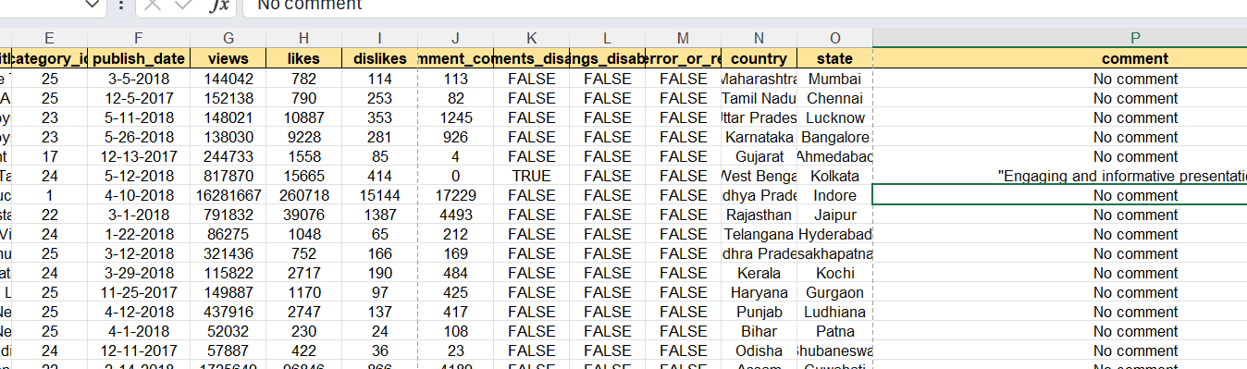
Q1
We can remove duplicates using , Remove duplicates from Data tab.
To fill missing values in the comment column, select the entire column and pres Ctrl +f. In find and replace , replace “blank” with No comment.

Slide 2
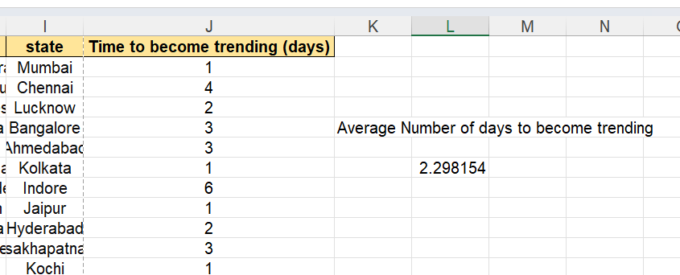
Q2
Calculate the time to become trending using the function = Days( Trending date-Publish Date). Next find the average treneding time using = Average ( J)

Slide 3
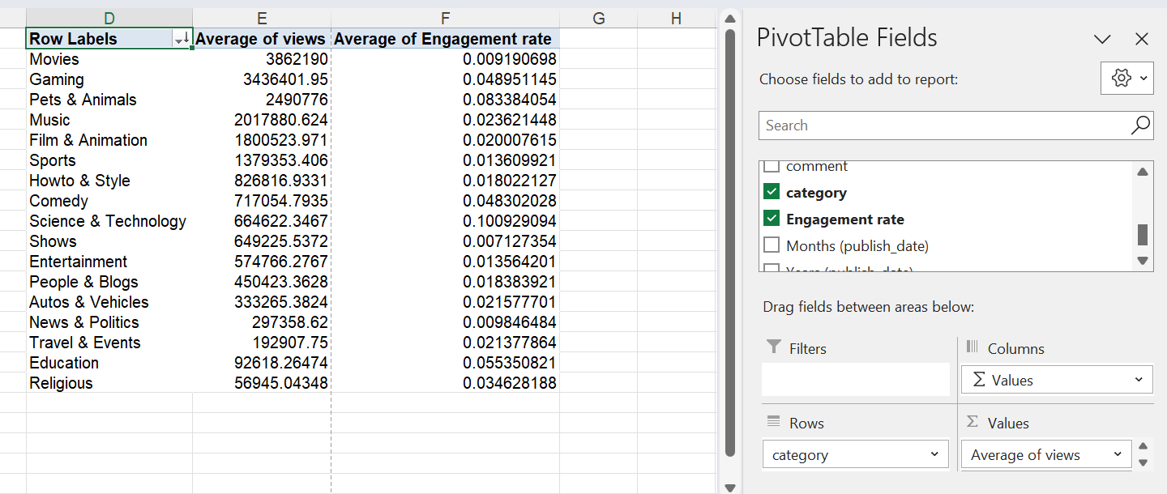
Q3
Engagement rate column is added into main. Engagement rate= (Likes + comments)/views ie. =(H2+J2)/G2
Sort the data according to descending order of average views. We observe Movies has the most average views but has a low engagement rate. Science and technology has a very high engagement rate.

Slide 4
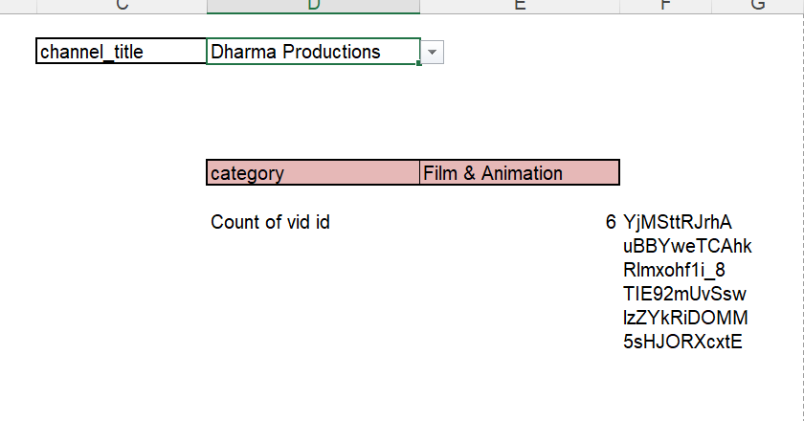
Q4
We enter the channel title as a data validation list. Next we find its category using xlookup.
=XLOOKUP(D2,'YouTube data'!D:D,'YouTube data'!Q:Q,,0)
To get the count we can use =COUNTA(FILTER('YouTube data'!A:A,'YouTube data'!D:D=Sheet5!D2))

Slide 5
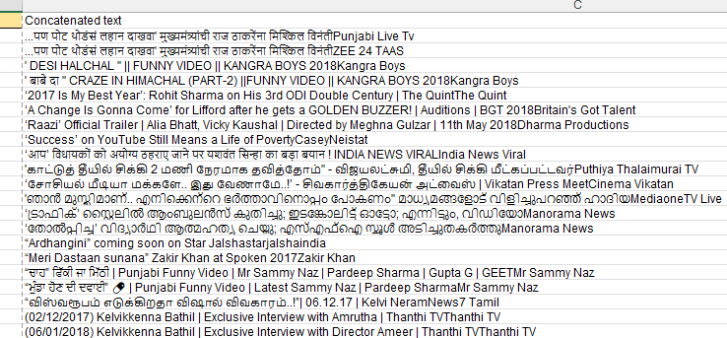
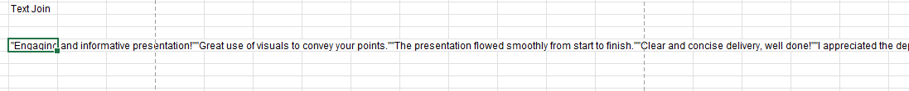
Q5
Use the formula for concat =CONCAT(A2,B2)
=TEXTJOIN(,TRUE,D2:D1048576)

Slide 6
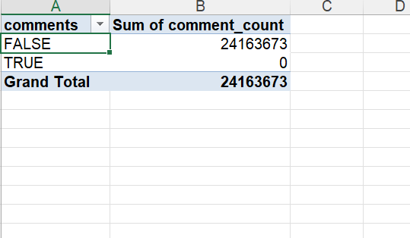
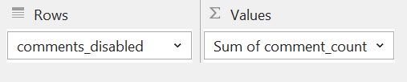
Q6
We use the following in pivot table For comments disabled true we have zero comments since the comments are disabled..

Slide 7
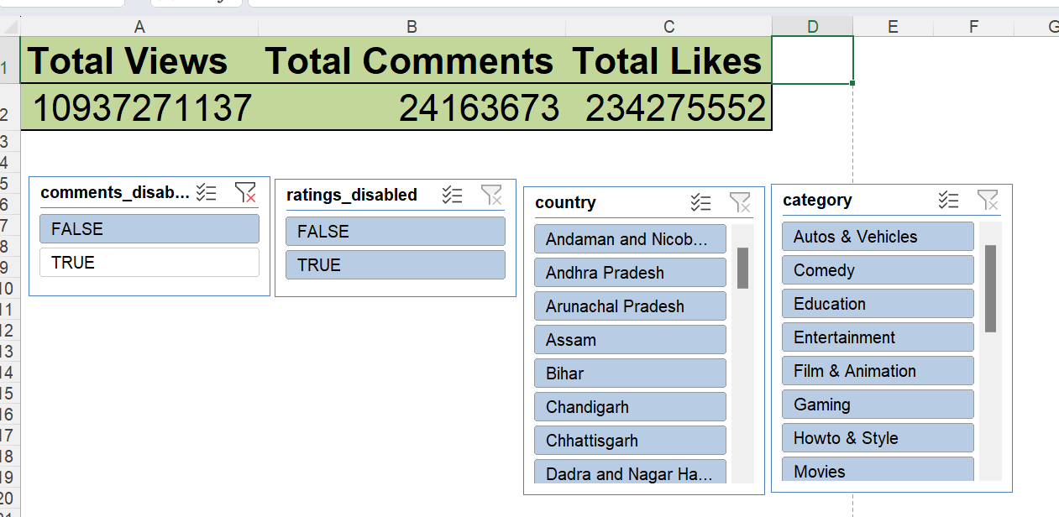
Q7
Views , comments , likes are aggregated using sum and kept in values in the pivot table . Then they are connected with slicers using report connections.

Slide 8
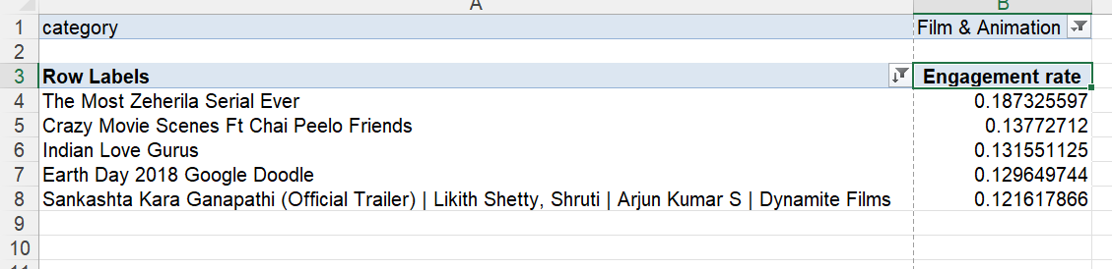
Q8
Based on the engagement rate we find top 5 videos within each category.

Slide 9
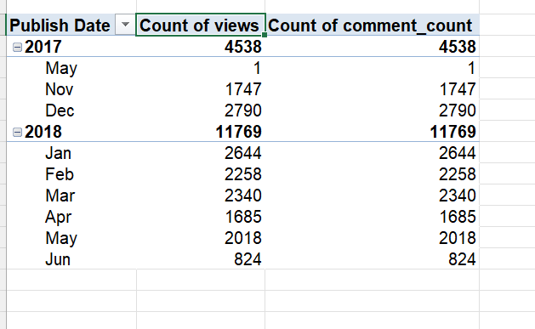
Q9
We observe that the views and comments increased in year 2018.

Slide 10
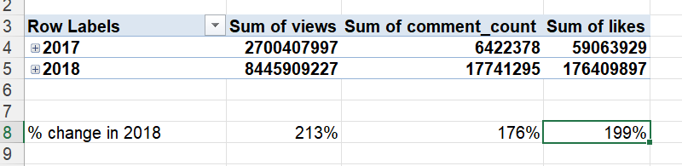
Q10
We observe the above 213%, 176% and 199% growth of views, comments and likes respectively.

Slide 11
Q11
category | (All)
comments_disabled | (All)
Row Labels | Sum of views
Jan | 1477 M
1-1-2018 | 56 M
1-2-2018 | 52 M
1-3-2018 | 46 M
1-4-2018 | 33 M
1-5-2018 | 44 M
1-6-2018 | 46 M
1-7-2018 | 23 M
1-8-2018 | 56 M
1-9-2018 | 18 M
1-10-2018 | 63 M
1-11-2018 | 43 M

Slide 12
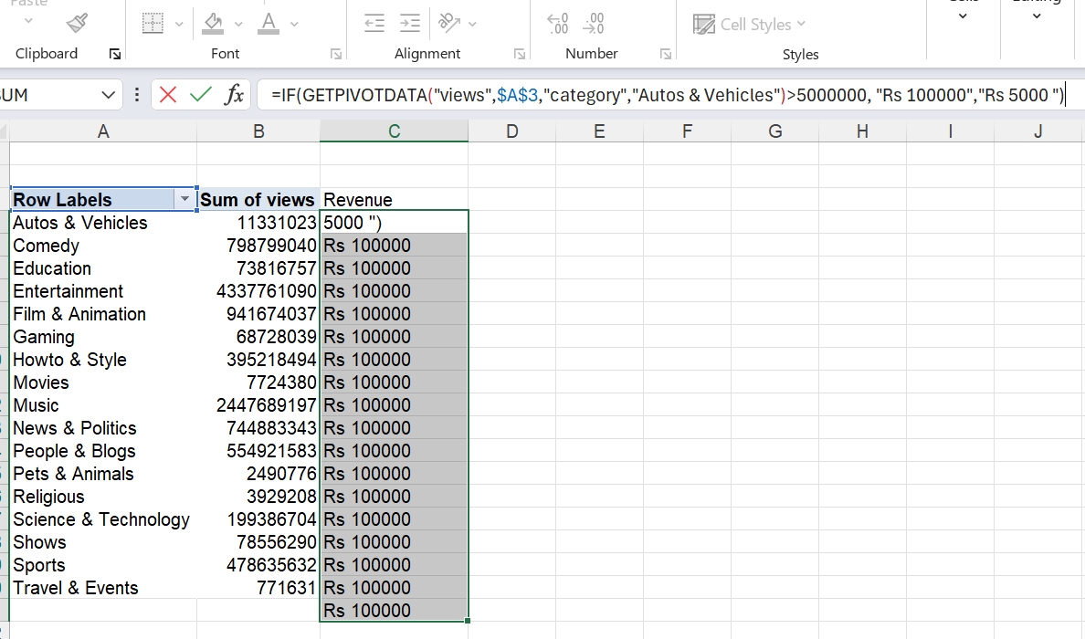
Q12

Slide 13
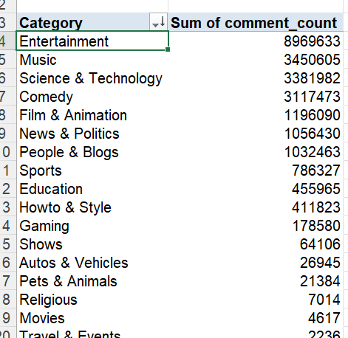
Q13
Entertainment category has the most viewer comments.

Slide 14
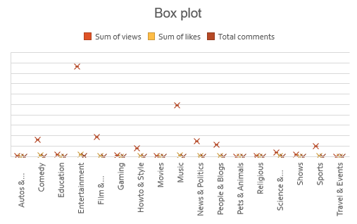
Q14
Entertainemet and music has significant outliers.
Entertainemt has the most views and comments.

Slide 15
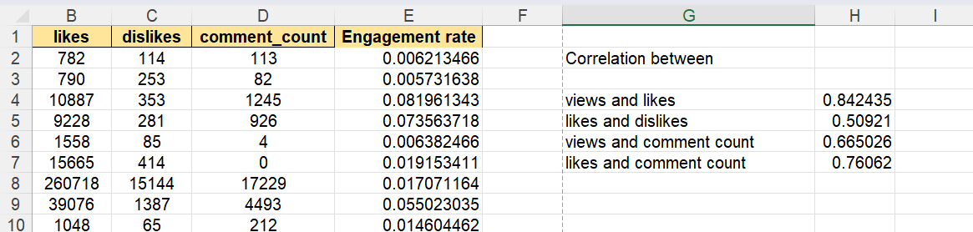
Q15
Views and likes have high positive correlation.

Slide 16
Q 16
Uttar Pradesh has the highest viewers.

Slide 17
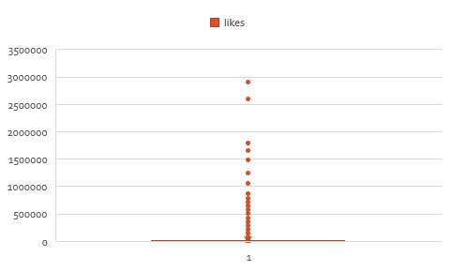
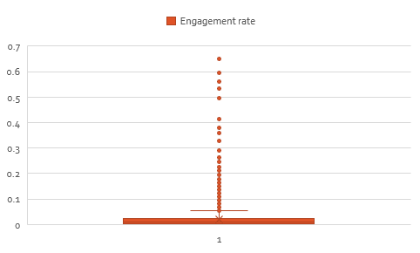
Q17

Slide 18
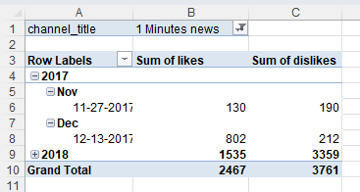
Q18
We can select different channels based on the filter channel title.

Slide 19
Q19
We see a steady growth

Slide 20
Q20
There isa a drastic change in dec.

